Slide 1
Special Congregational Meeting, March 5
Welcome

Slide 2
Special Congregational Meeting, March 5
Agenda
Meeting Called to Order
Jeff Block, President
Overview of the City’s Public Works Project and the Easement Details
Pastor Peter, with David Rodriguez and Sara Masters
City’s Financial Offer for the easement, project easement and parking. Recommendation for use of easement funds.
Karl Starr, Treasurer
Recommendation and Vote
Jeff Block
Adjourn

Slide 3
Special Congregational Meeting, March 5
Overview of the City’s Public Works Project and the Easement Details
Public works project on 3rd Ave
The project includes a new sanitary sewer line underneath the south end of the parking lot
The project is schedule to begin April 1 and conclude October 1 (6 months).
The 3rd Ave parking entrance will be open during the project, 3rd Ave may be at one lane from time to time
There is a construction easement and then the permanent easement.
The permanent easement will provide the City access for maintaining the sewer line. The parking lot will be returned for use by the Church.

Slide 4
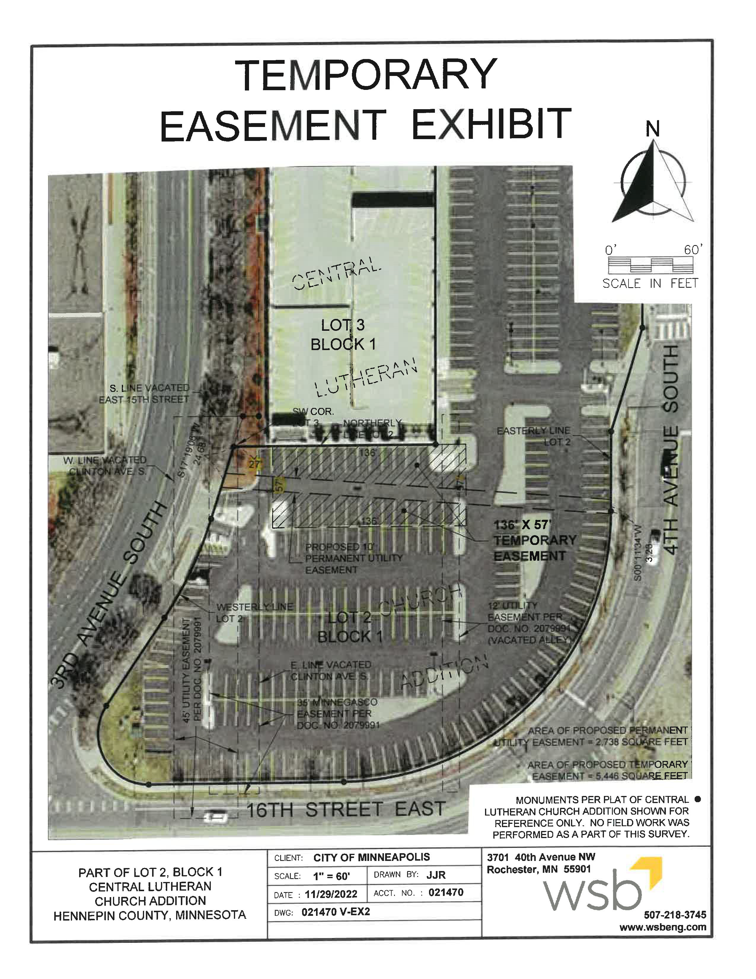
Special Congregational Meeting, March 5

Slide 5
Special Congregational Meeting, March 5
Summary of Acquisition
Current Land Value | 118,500 SF $90 per SF | $10,674,000
Offer from City
Permanent Utility Easement | 2,738 SF $90 per SF 70% loss in value | $172,494
Temporary Easement | 5,446 SF $90 per SF 10% easement rate 6-month term | $25,000
Temporary Parking Impact | 26 parking stalls $1,000 per stall | $26,000
Total offer |  | $223,494

Slide 6
Special Congregational Meeting, March 5
Use of funds
To current year operating fund:
$26,000
Split with Allied Parking per revenue sharing formula
Reserve for future capital projects:
$197,494
Total of the two easement payments
Allocate to “Long-term projects” and/or “Consumables” account under stewardship of Fiscal & Properties Committee
Any expenditure exceeding 3% of total annual budget to be approved by congregation
Total settlement:
$223,494

Slide 7
Special Congregational Meeting, March 5
Motion and second to approve
Discussion
Vote
Adjourn
Thank you for being here today!

